Slide 1

Cafe Sales Analysis
September 19th 2025
Notes:
Good morning, everyone. My name is [Your Name], and today I will present the final project for DS101, an analysis of a cafe sales dataset. The goal of this analysis is to identify key trends and provide actionable recommendations to boost business growth.

Slide 2

Agenda
1
Project Objectives & Data Overview
2
Data Exploration & Cleaning Process
3
Key Findings from Data Analysis
4
Strategic Business Suggestions
5
Conclusion
1
Notes:
Our presentation today will cover five main areas: First, the project objectives and data overview. Second, the detailed data cleaning process. Third, the key findings from our analysis of the sales data. Fourth, some strategic suggestions based on those findings. And finally, a summary of our conclusions.

Slide 3
01
1. Project Objectives & Data Overview
2
Notes:
Let's start with the objectives of this project and a brief overview of the dataset we used.

Slide 4

Project Objectives
Analyze cafe sales data to understand customer buying patterns and market trends
Identify sales distribution and seasonal patterns etc.
Provide recommendations to support business growth and marketing strategies
3
Notes:
The primary objective of this study was to analyze a cafe sales dataset. We aimed to understand customer buying patterns and market trends by identifying sales distribution and seasonal patterns. Ultimately, our goal was to provide data-driven recommendations that could support business growth and marketing strategies.

Slide 5
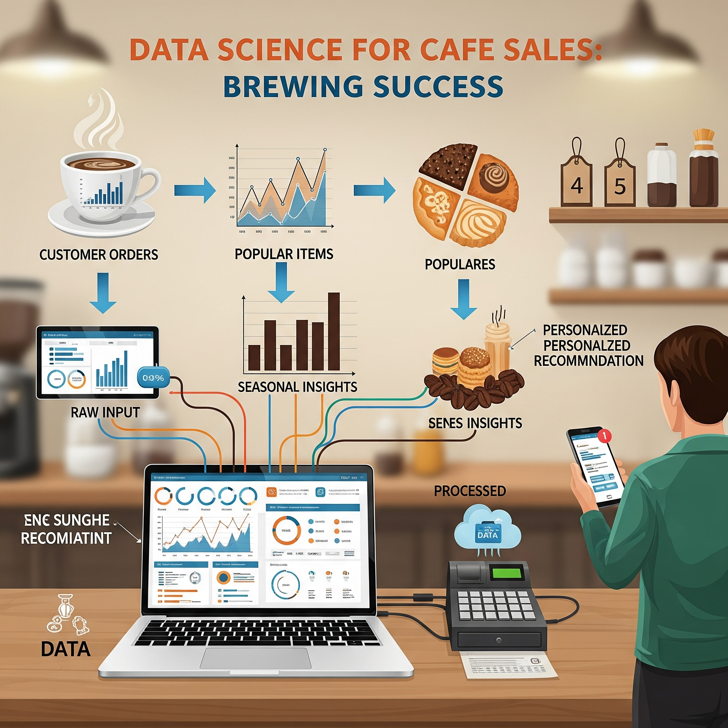
Dataset Overview
10,000 synthetic sales transactions from 2023
Columns: Transaction ID, Item, Quantity, Price Per Unit, Total Spent, Payment Method, Location, Transaction Date
Each row represents a single transaction
4
Notes:
The dataset contains 10,000 synthetic sales transactions from the year 2023. Each row details a single transaction, including information like the item purchased, quantity, price, and payment method.

Slide 6

Tools
Data cleaning and exploration: Python
Data analysis: Python and Tableau
Create slides: Google slides with Gemini
4
Notes:
The dataset contains 10,000 synthetic sales transactions from the year 2023. Each row details a single transaction, including information like the item purchased, quantity, price, and payment method.

Slide 7
02
2. Data Exploration & Cleaning
5
Notes:
Next, I'll walk you through the process of exploring and cleaning the raw data, which was crucial before any meaningful analysis could begin.

Slide 8
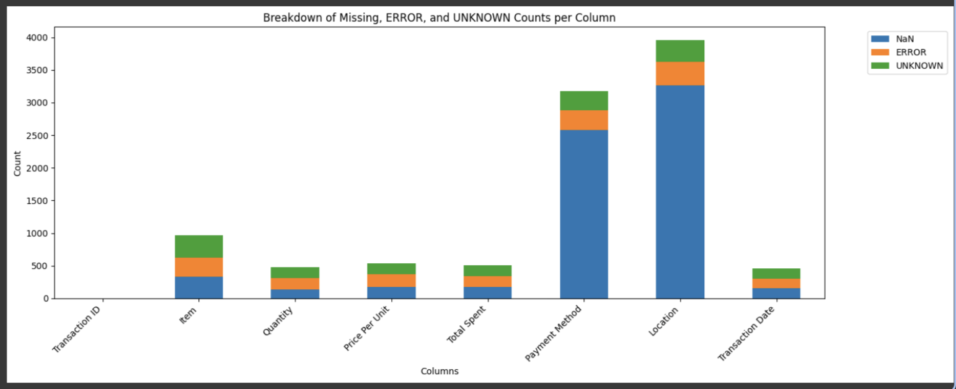
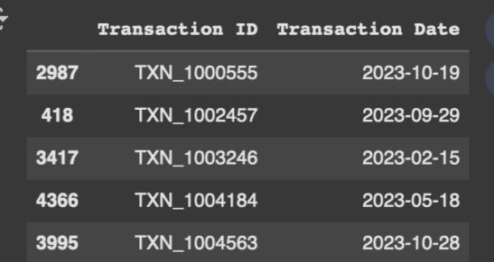
Initial Data Quality Issues
The dataset contained some problems and limitations.
All columns were initially of the 'object' data type
Significant number of null or error values found across multiple columns
Specifically, `Location` and `Payment Method` had the most issues
No relationship between `Transaction ID and Date`
6
Notes:
Upon initial inspection, we found that all columns were incorrectly formatted as 'object' types. More importantly, there were many missing and error values, especially in the 'Location' and 'Payment Method' columns, as shown in the chart on the right.

Slide 9
Data Cleaning Process
1
Replace 'ERROR' and 'UNKNOWN' values with NaN
2
Convert numeric columns to float64 and dates to datetime format
?
3
Drop rows with NaN Transaction Date (Changed row count from 10,000 to 9,540)
?
4
Calculate and fill in missing Item and Price Per Unit values based on their fixed relationship
?
5
Iteratively calculate and fill in missing values for Quantity, Price Per Unit, and Total Spent using each other's data
6
Recalculate and fill in missing Item and Price Per Unit values based on their fixed relationship
7
Add Weekday and Month column to analyze weekday and season trend
?
8
Replace missing values to median for Quantity, Price Per Unit, and Total Spent
Notes:
Our data cleaning process was a multi-step workflow. First, we replaced textual error values with NaN. Then, we corrected data types. A key decision was to drop rows with missing transaction dates, as all transactions were from 2023. The most complex step was the iterative filling of missing values for Quantity, Price, and Total Spent, as well as using the fixed price-item relationship to fill in other missing values.

Slide 10
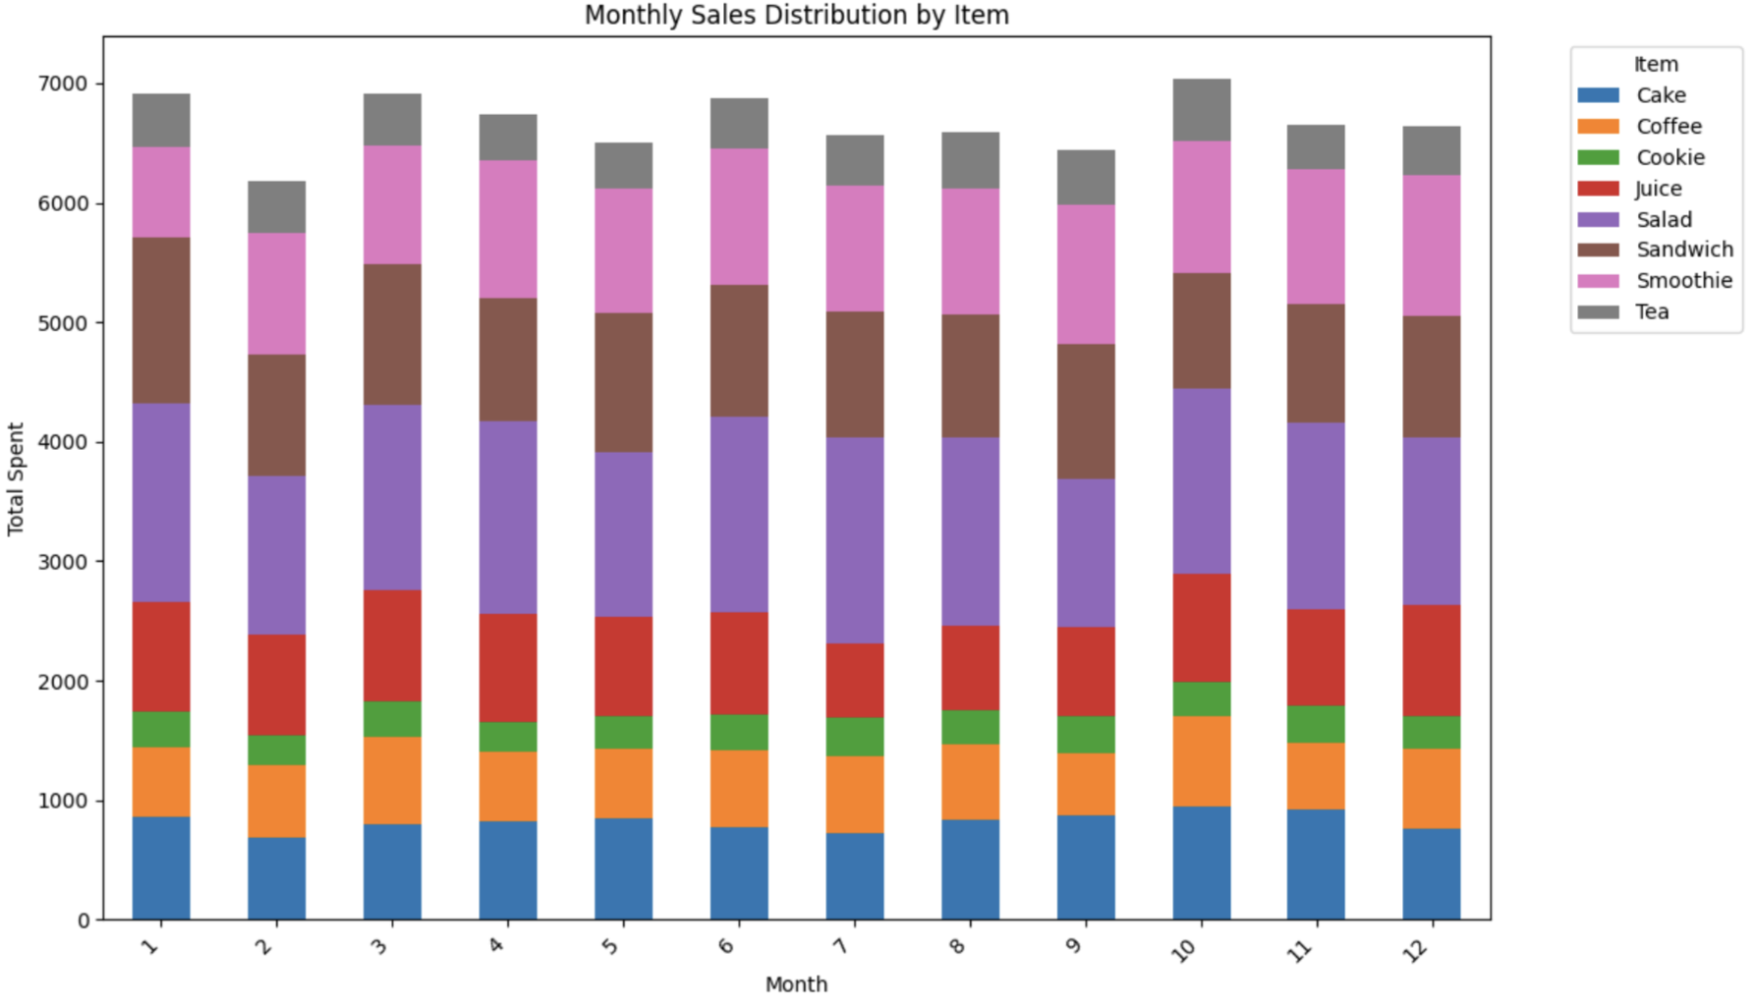
Data Cleaning Process
3
Drop rows with NaN Transaction Date (Changed row count from 10,000 to 9,540)
Transaction Date is only in 2023
If there is another year data, it will be noise
Decided to drop error value of `Transaction Date`
Notes:
Our data cleaning process was a multi-step workflow. First, we replaced textual error values with NaN. Then, we corrected data types. A key decision was to drop rows with missing transaction dates, as all transactions were from 2023. The most complex step was the iterative filling of missing values for Quantity, Price, and Total Spent, as well as using the fixed price-item relationship to fill in other missing values.

Slide 11
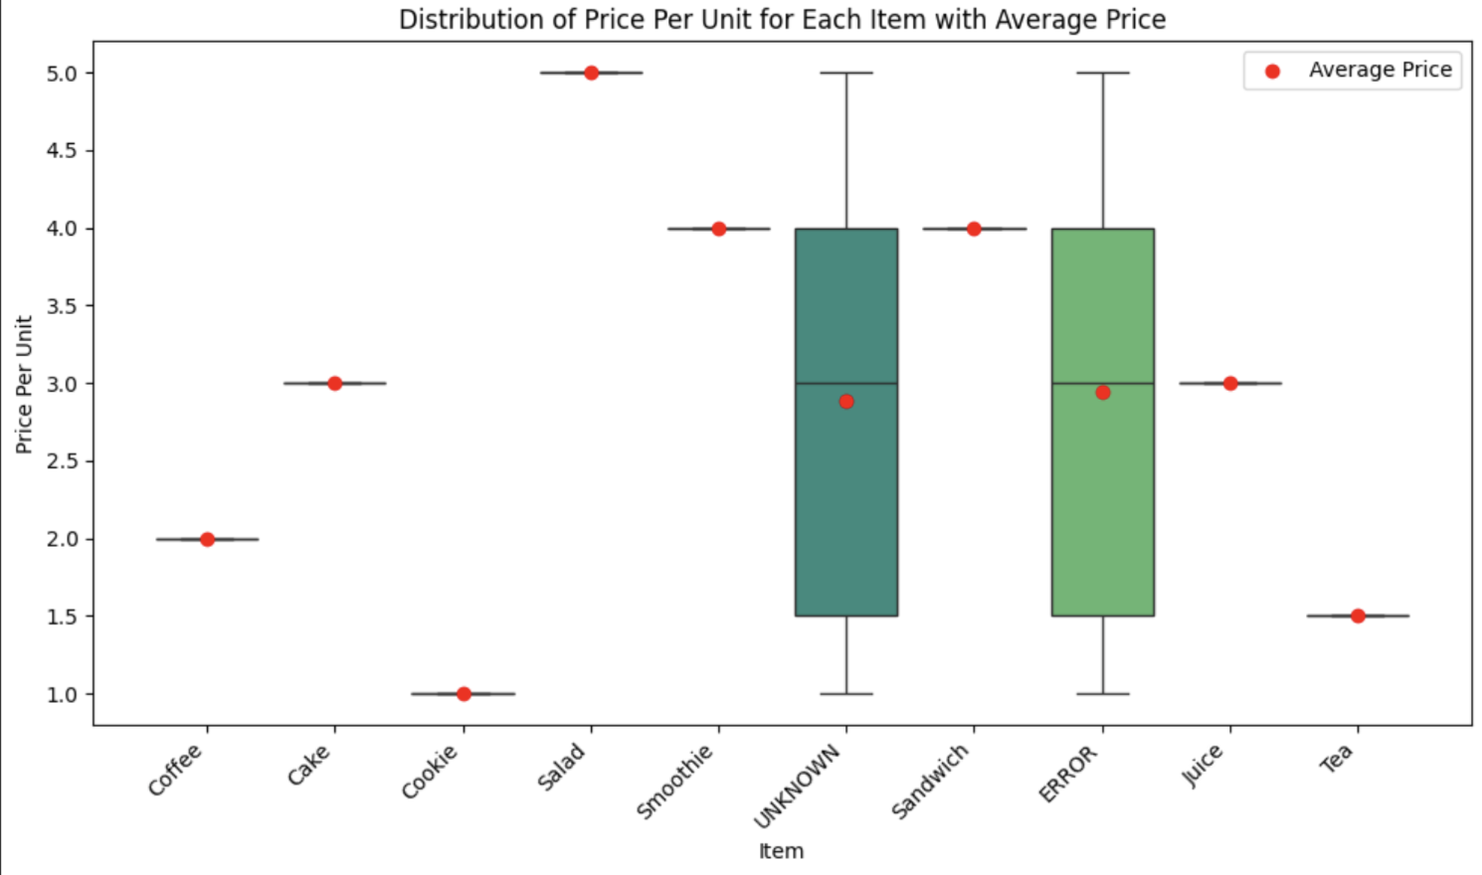
Data Cleaning Process
4
Calculate and fill in missing Item and Price Per Unit values based on their fixed relationship
Each item has fixed price
`Item` and `Price Per Unit` can be inferred
from each other
Notes:
Our data cleaning process was a multi-step workflow. First, we replaced textual error values with NaN. Then, we corrected data types. A key decision was to drop rows with missing transaction dates, as all transactions were from 2023. The most complex step was the iterative filling of missing values for Quantity, Price, and Total Spent, as well as using the fixed price-item relationship to fill in other missing values.

Slide 12
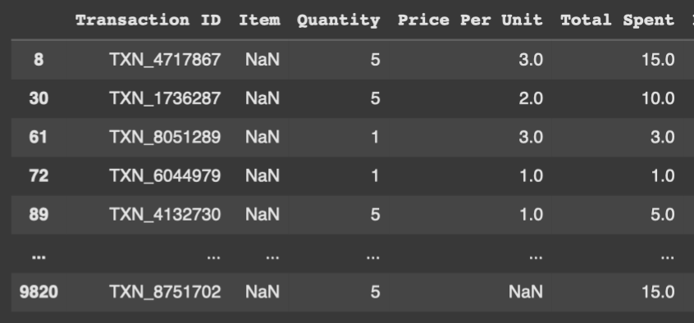
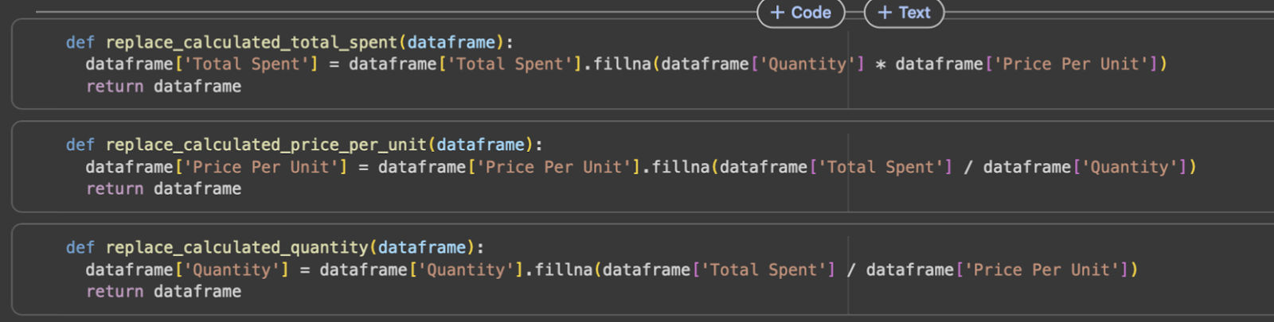
Data Cleaning Process
5
Iteratively calculate and fill in missing values for Quantity, Price Per Unit, and Total Spent using each other's data
Notes:
Our data cleaning process was a multi-step workflow. First, we replaced textual error values with NaN. Then, we corrected data types. A key decision was to drop rows with missing transaction dates, as all transactions were from 2023. The most complex step was the iterative filling of missing values for Quantity, Price, and Total Spent, as well as using the fixed price-item relationship to fill in other missing values.

Slide 13
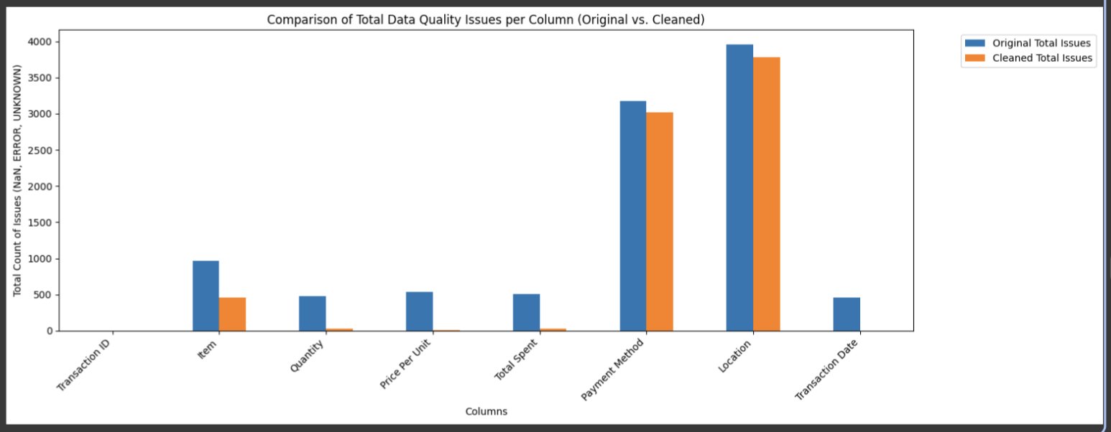
Data Quality Improvement
Significantly reduced data issues after cleaning process
8
Notes:
As you can see from this table, our cleaning efforts significantly improved the data quality. The most dramatic improvements were in the 'Transaction Date', 'Quantity', and 'Price Per Unit' columns, with their non-null ratios reaching near 100%.

Slide 14
Data Quality Improvement
Significantly reduced data issues after cleaning process
Column
Original Non-issue (%)
Cleaned Non-issue (%)
Change (%)
Transaction Date
95.3%
100.0%
+4.7%
Quantity
95.2%
99.8%
+4.6%
Price Per Unit
94.7%
99.9%
+5.2%
Total Spent
95.0%
99.8%
+4.8%
Item
95.0%
95.2%
+0.2%
8
Notes:
As you can see from this table, our cleaning efforts significantly improved the data quality. The most dramatic improvements were in the 'Transaction Date', 'Quantity', and 'Price Per Unit' columns, with their non-null ratios reaching near 100%.

Slide 15
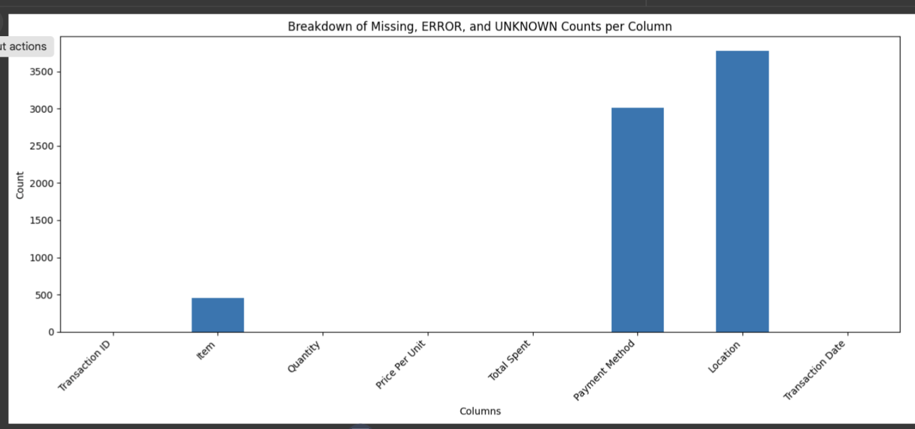
Data Cleaning Process
8
Replace missing values for Quantity, Price Per Unit, and Total Spent to median
Column | Median
Quantity | 3.0
Price | 3.0
Total Spent | 8.0
Notes:
Our data cleaning process was a multi-step workflow. First, we replaced textual error values with NaN. Then, we corrected data types. A key decision was to drop rows with missing transaction dates, as all transactions were from 2023. The most complex step was the iterative filling of missing values for Quantity, Price, and Total Spent, as well as using the fixed price-item relationship to fill in other missing values.

Slide 16
Data Quality Improvement
Significantly reduced data issues after cleaning process
Column
Original Non-issue (%)
Cleaned Non-issue (%)
Change (%)
Transaction Date
95.3%
100%
+4.7%
Quantity
95.2%
100%
+4.8%
Price Per Unit
94.7%
100%
+5.3%
Total Spent
95.0%
100%
+5.0%
Item
95.0%
95.2%
+0.2%
8
Notes:
As you can see from this table, our cleaning efforts significantly improved the data quality. The most dramatic improvements were in the 'Transaction Date', 'Quantity', and 'Price Per Unit' columns, with their non-null ratios reaching near 100%.

Slide 17
03
3. Data Analysis, Suggestions
&
Business Strategy
9
Notes:
Now that the data is clean, let's move on the… In my part, I’ll tell you about analysis and strategy, focusing each Items.

Slide 18
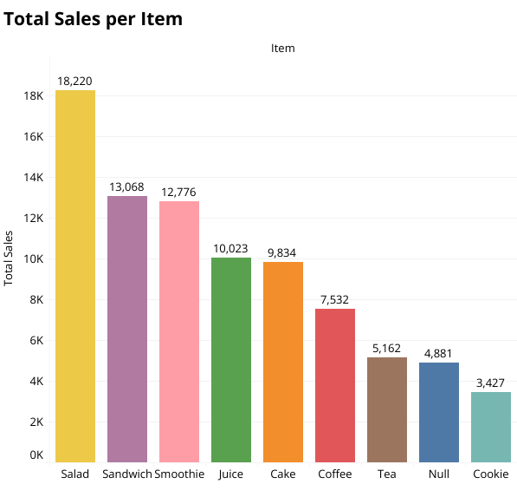
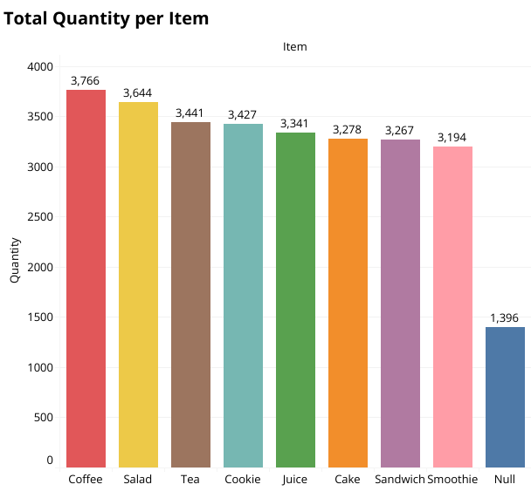
Top Performers by Sales & Quantity
A health-conscious trend Breakfast/lunch use
Beverages bring customers in daily
Total Sales Leader
Consistent Performers
Sales Volume Leader
Salad
Sandwich & Smoothie
Coffee
$18,220
Stable year-round
3,766 units
Notes:
From our sales data, we identified the top-performing items. Salad is clearly the top in total revenue (over 18,000) Interestingly, In sales volume, coffee is the top (with over 3,700 units sold) Meanwhile, Sandwiches and Smoothies are strong, consistent performers throughout the year.
We can see a health-conscious trend, by the demand for salads.
Beverages bring customers in daily

Slide 19
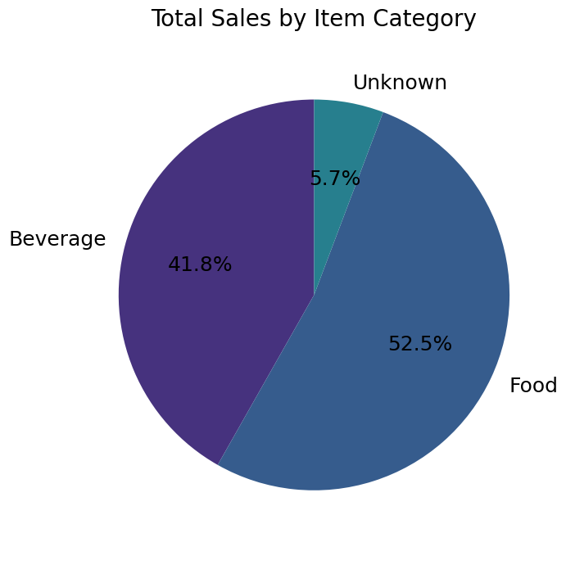
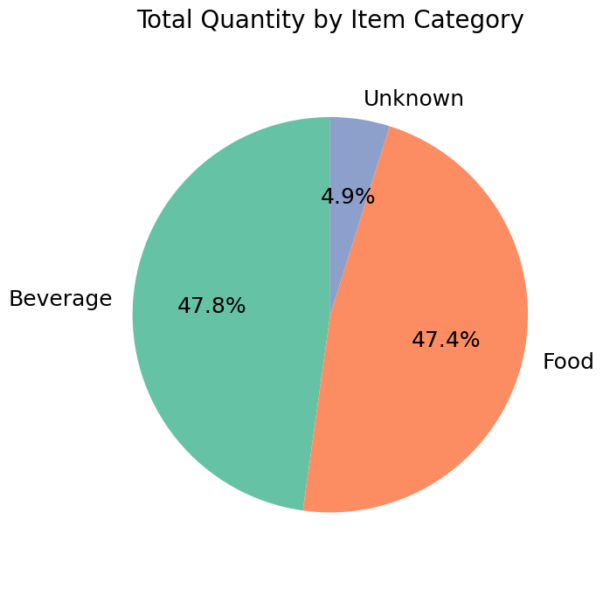
Sales Breakdown by Category
Food brings more revenue per unit
Customers often combine beverages + food
Revenue
Quantity
Food (52.5%) > Beverages (41.8%)
Beverages (47.8%) ≈ Food (47.4%)
Notes:
A deeper look at the item categories reveals a key insight. Food items generate more revenue overall, accounting for 52.5% of total sales. However, beverages sell in nearly equal quantity to food
Beverages bring customers in daily( coffee is the top quantity as we saw in a previous slide)

Slide 20
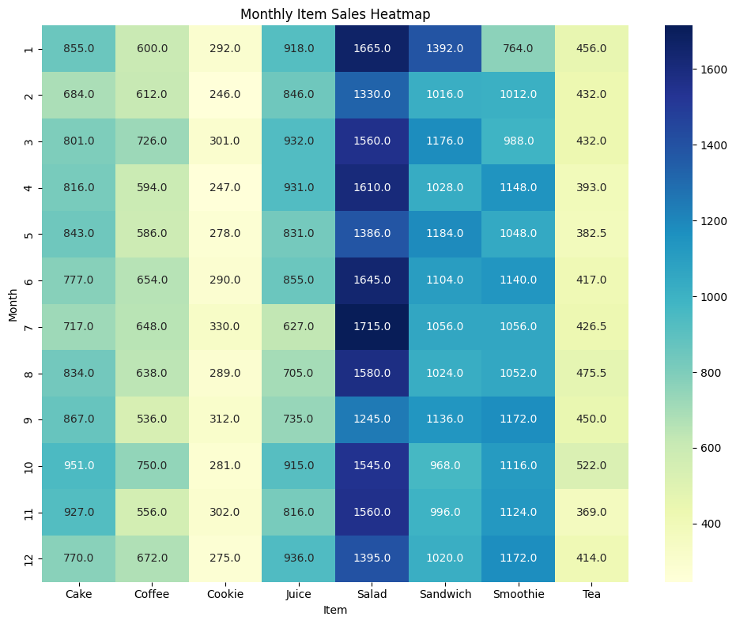
Seasonal Sales Trends
Salads & Tea : weather-driven demand
Cakes : possibly tied to fall/holiday
occasions
Sandwiches & smoothies: reliable steady
products
Juice: sales have strong growth potential.
• Salads: Strong demand in summer,
peaking in June-July
• Cakes: A notable rise in October,
possibly due to fall/holiday seasons
• Tea: A slight increase
during colder winter months
・Juice: A downward trend in summer
Notes:
Our analysis of monthly sales revealed some clear seasonal patterns.
For example, salad sales surge during the summer, We also observed a peak in cake sales in October, Tea sales, as expected, increase slightly in colder months.
reflecting weather-driven demand. Cakes likely tied to holidays like Halloween. Juice,

Slide 21
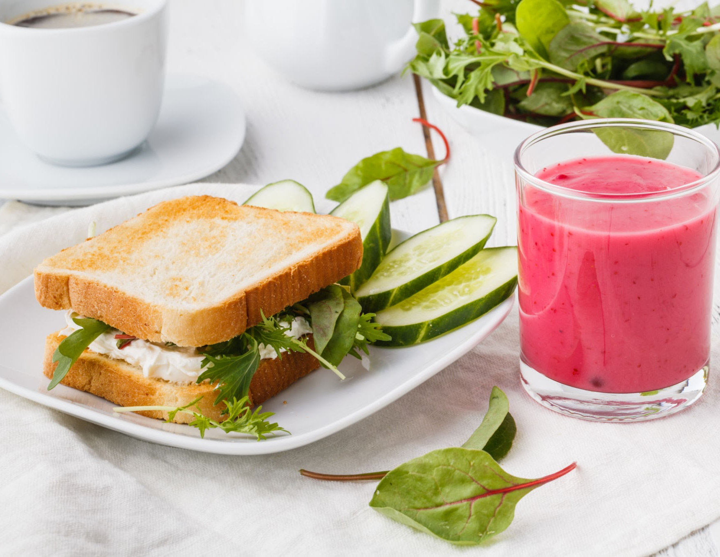
Reinforce Core Staples
Focus on sandwiches and smoothies to drive consistent growth
Offer Set Menus like Coffee + Sandwich
Encourage upselling with deals
such as "Add a smoothie to your sandwich for 20% off"
Position sandwiches & smoothies
as the "Everyday Healthy Choice"
Notes:
Sandwiches and smoothies are already consistent performers, so we should focus on reinforcing them. We can introduce combo sets to increase the average order value and To Promote set menus, like coffee with sandwiches, or upselling deals with smoothies. position these items as healthy choices for everyday customers. Position sandwiches and smoothies as “everyday healthy choices.”

Slide 22
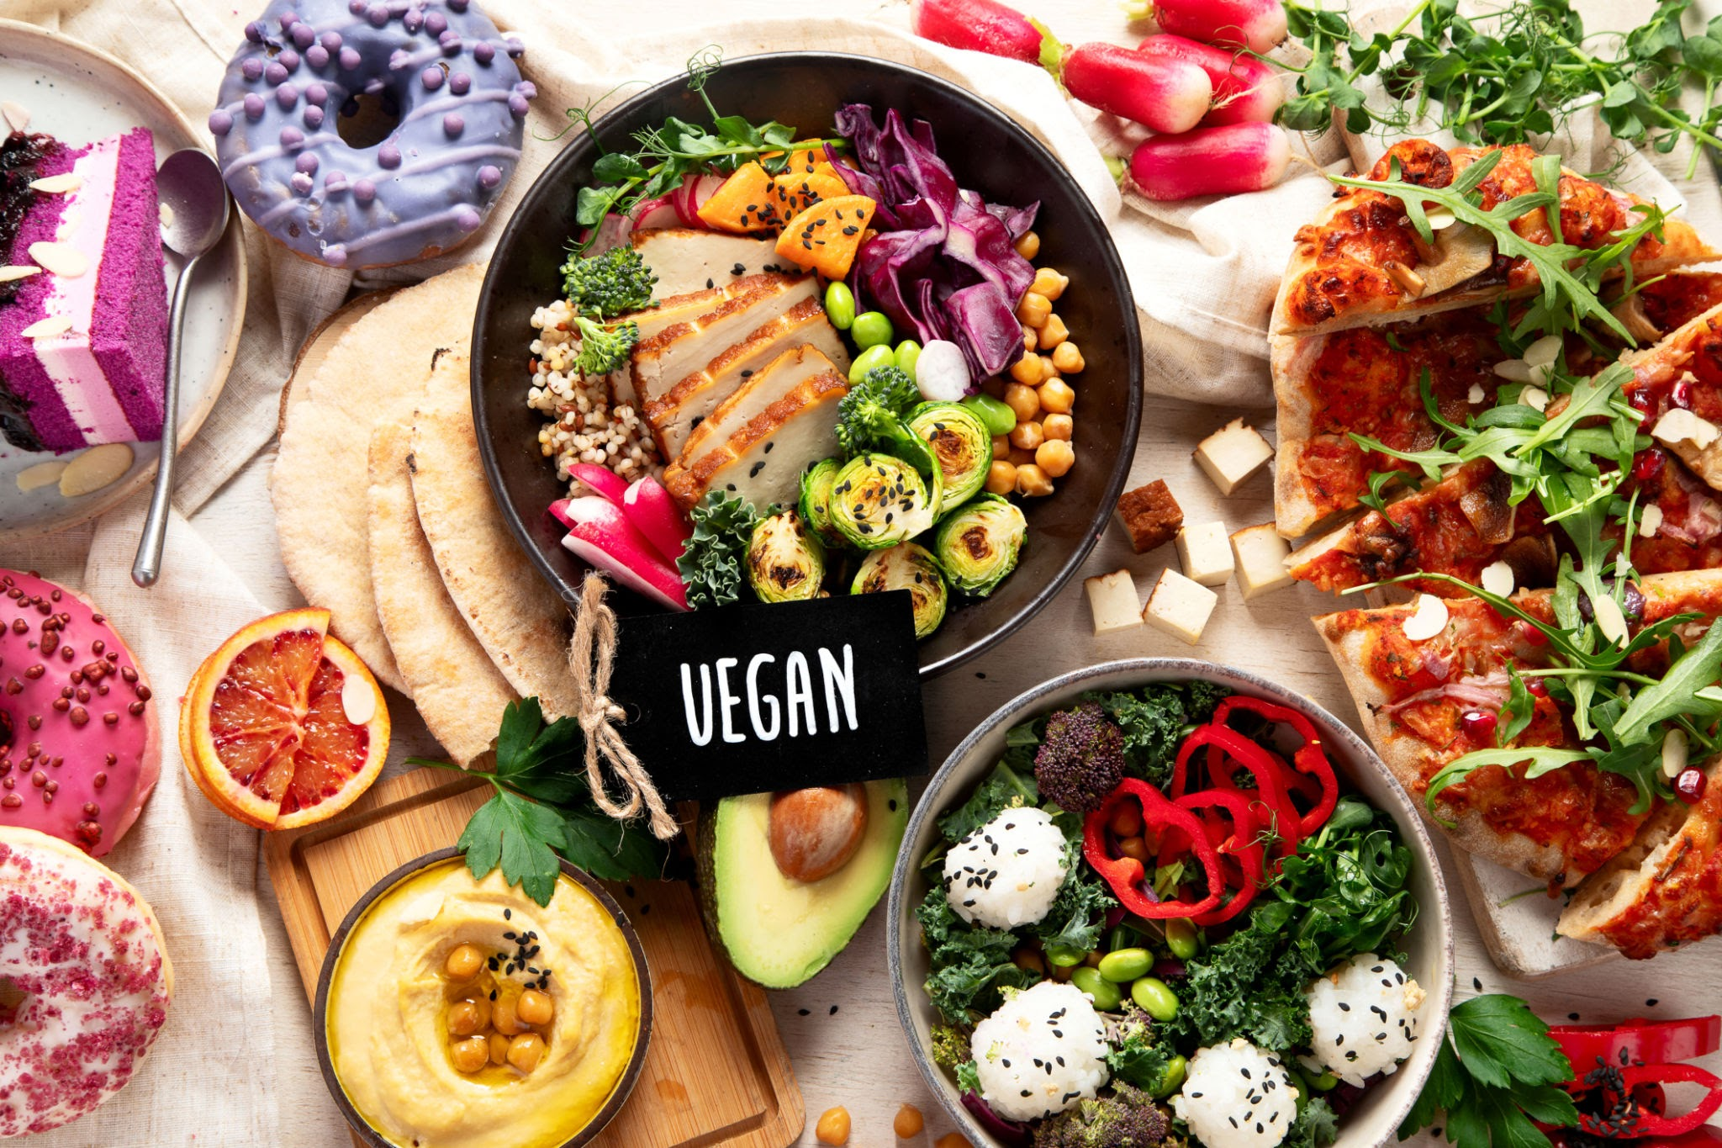
Strengthen the Meal Menu
Expand the menu to capture more breakfast and lunch traffic
• Add more variety to salads and sandwiches
• Introduce seasonal lunch bowls like soups in winter or fresh bowls in summer
• Allow add-ons such as extra protein, vegan, or gluten-free options
Notes:
The data suggests strong demand during breakfast and lunch hours. To capture this, we recommend strengthening the meal menu. This includes adding more variety to core items, introducing seasonal options like winter soups, and offering customizable add-ons to cater to health-conscious customers.

Slide 23

Utilize Seasonal patterns
Seasonal Promotions
new items tied to holidays
(Halloween cookies, Christmas cakes,Valentine’s desserts)
Fit beverages with weather demand (iced drinks in summer, warming teas and coffees in winter)
Reintroduce successful limited-time flavors annually
(e.g. pumpkin spice, seasonal fruit flavor)
Notes:
By capitalizing on trends,
we suggest making use of seasonal patterns.
This includes introducing holiday-themed products. Launch seasonal promotions tied to holidays and weather.
Introduce limited-time drinks and reintroduce proven favorites annually (e.g., pumpkin spice, seasonal fruit).
Use these limited-time items to attract customers and build loyalty.

Slide 24
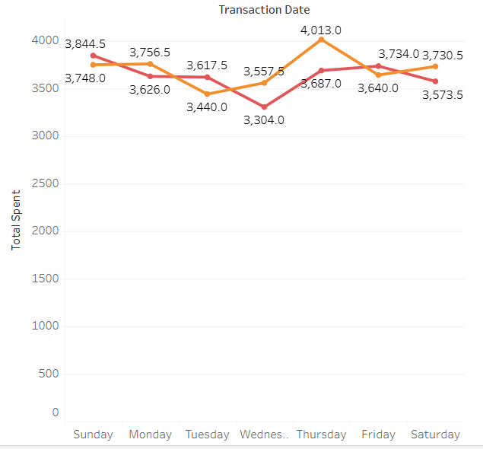
Total Spent(In total of week)
Our data shows that red dots (take-away transactions) are significantly lower on:

Slide 25
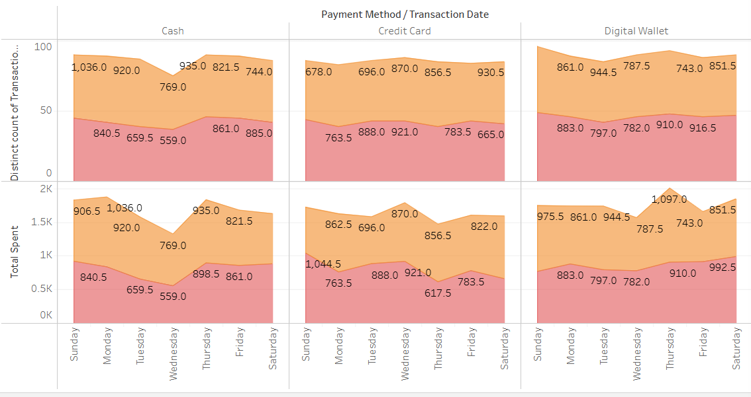
Payment Method and Location(Week)

Slide 26
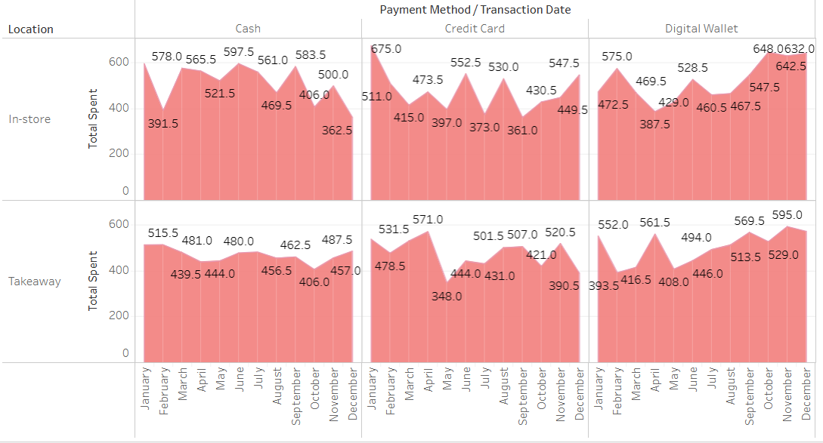
Payment Method and Location(Month)

Slide 27

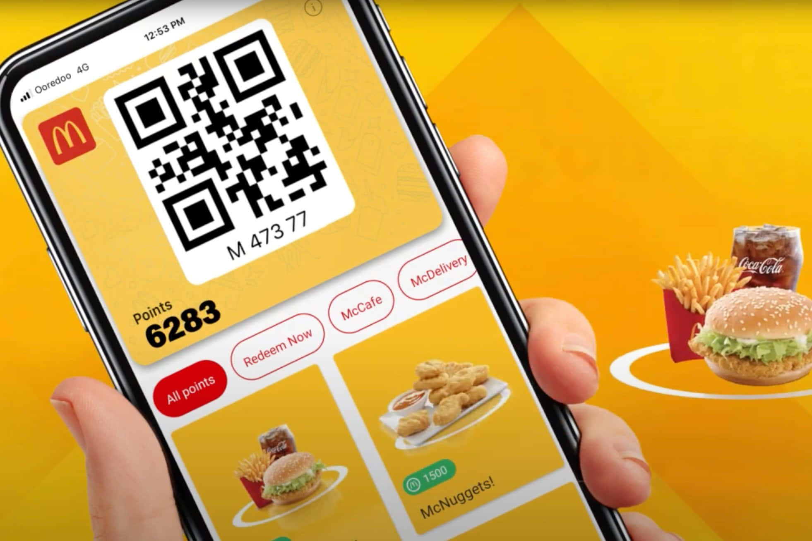

Opportunity for attract people & loyalty

Slide 28
05
5. Conclusion
Notes:
To conclude, let's summarize the main takeaways and our final recommendations.

Slide 29
Project Conclusion
Weekday Improvements: Take an advantage of our weak weekdays in order to increase our take away area.
• Top Performers: Salads, sandwiches, and smoothies are the main revenue drivers
• Sales Volume: Coffee leads in quantity sold and is a daily-use item
• Key Opportunities: Clear seasonal trends and a chance to expand the meal menu so we can get a new advantage of that
Notes:
In conclusion, our analysis confirmed that salads, sandwiches, and smoothies are the cafe's main revenue drivers, while coffee serves as a high-volume, daily-use item. The data also showed clear seasonal trends, presenting a great opportunity for targeted menu design and promotions.

Slide 30


